Slide 1
Test Plan
[B-ACC-2] Promote Account Signup May 1, 2020
Prepared by Adobe Consulting April 2020

Slide 2
Contents
Overview
Design
Specifications
Results

Slide 3
1. Overview

Slide 4
Overview [B-ACC-2] Promote Account Signup
DEVICES All Device Types
LOCATION PackersProShop.com: Checkout
METRICS Primary: Account Signups (e35)
Secondary: Conversion Rate and Revenue per Visitor
AUDIENCES All Visitors
REVENUE N/A
HYPOTHESIS
Showcasing the benefits of creating an account throughout the checkout process will increase account signups and inevitably drive repeat purchases.
BUSINESS OBJECTIVE
Drive account signups by promoting the value of creating an account during checkout.

Slide 5
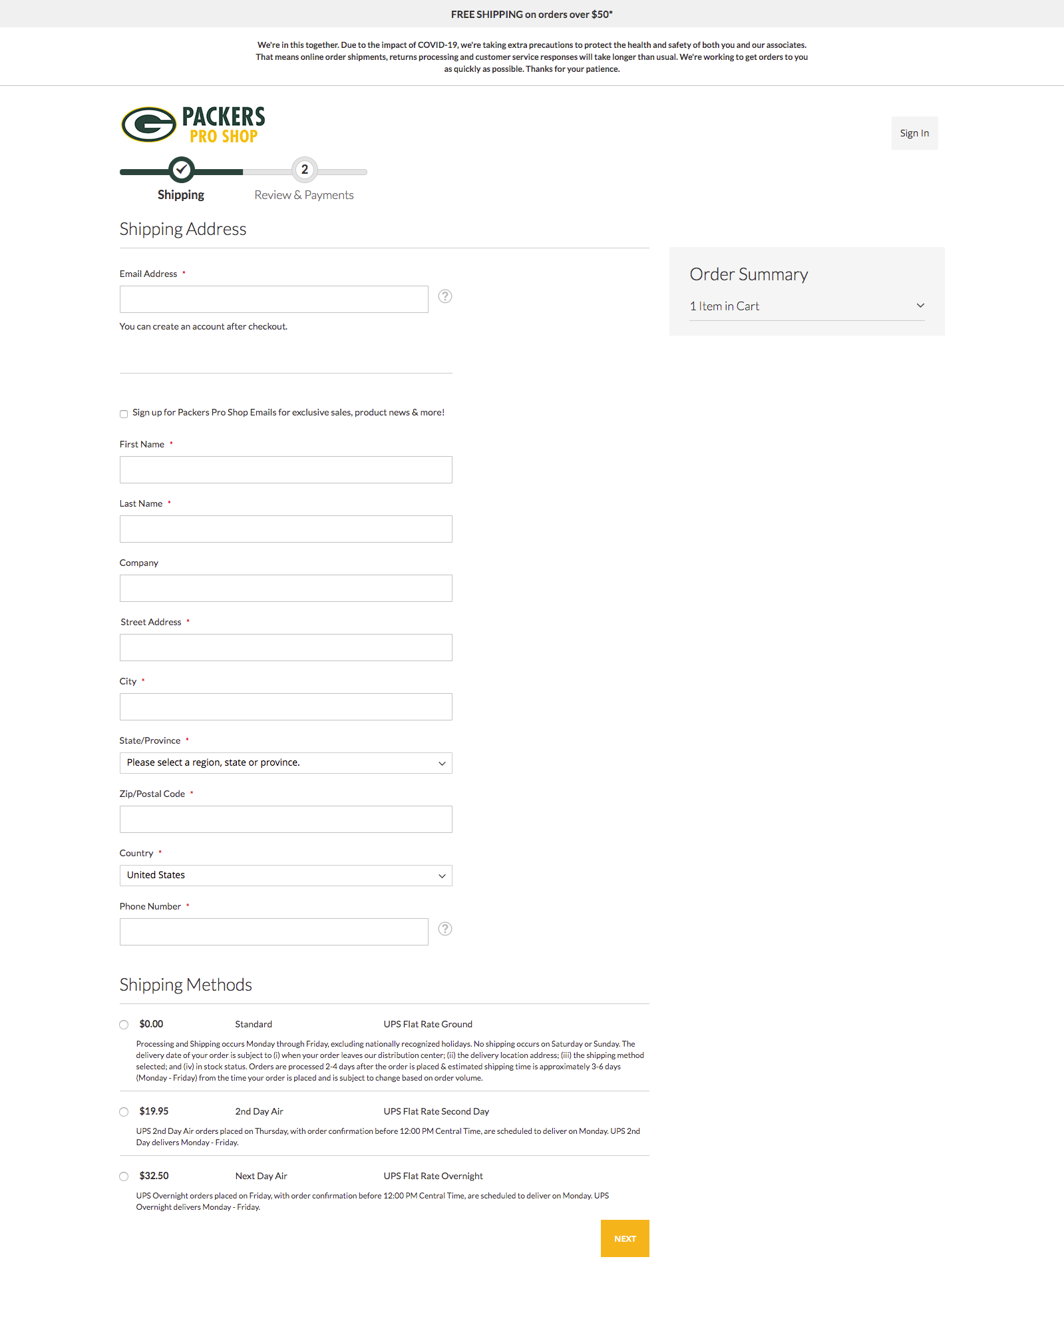

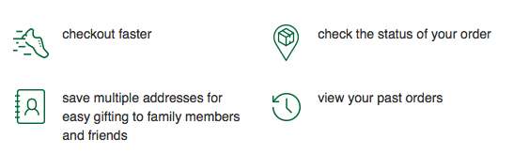

Overview [B-ACC-2] Promote Account Signup
CHECKOUT EXPERIENCES
A – Default Checkout – No Account Signup Promo
DEVICES All Device Types
LOCATION PackersProShop.com: Checkout
METRICS Primary: Account Signups (e35)
Secondary: Conversion Rate and Revenue per Visitor
AUDIENCES All Visitors to Checkout
REVENUE N/A
B – Add Account Signup Promo to Checkout

Slide 6
2. Design

Slide 7
Design [B-ACC-2] Promote Account Signup
A – Default Checkout – No Account Signup Promo

Slide 8
Design [B-ACC-2] Promote Account Signup
B – Add Account Signup Promo to Checkout

Slide 9
3. Specifications

Slide 10
Specifications [B-ACCT-2] Promote Account Signup
ACTIVITY TYPE A/B
NUMBER OF LOCATIONS URL contains https://www.packersproshop.com/checkout/
CHALLENGERS Add Account Signup Promo
TARGETING
All Visitors
VISITORS Segment 1: # 495 Per Day
METRICS Primary: Account Signups (e35)
Secondary: Conversion Rate and Revenue per Visitor
*NOTE* Moved Conversion Rate to Primary due to time to complete test.
CONVERSIONS Metric 1 (Account Signups (e35)): 20 Per Day
Metric 2 (Orders): 214 Per Day
TEST DURATION 170-664 days to reach significance for a 5-10% lift in Account Signups (e35)
9-34 days to reach significance for a 5-10% lift in Conversion Rate

Slide 11
4. Results

Slide 12
Results [X-YY-N] Test Name Here | ##/##/## – ##/##/##
Results Data Graph and/or chart

Slide 13
Results [X-YY-N] Test Name Here | ##/##/## – ##/##/##
[Discovery] | We found that.. |  | X Visitors Metric +$33,747
[Next Step] | We should now do this.. |  | Y Visitors Metric +$5,190
[Next Step] | Implement an enhancement to implementation |  | 4,143,612 Visitors Flat Results No Added Lift
[Recommend] | Test a follow up that does x, y, z |  | Z Visitors Metric +10%
[Recommend] | Consider iterating current design |  | X Visitors Metric +43%

